Slide 1
Return on Investment (ROI) Infographics
Here is where this template begins

Slide 2
Return on investment (ROI) infographics
Return on investment
 | Mercury
 | Mercury is the closest planet to the Sun
 | Jupiter
 | Jupiter is the biggest planet of them all
 | Mars
 | Despite being red, Mars is a cold place
45%
ROI
160%
Yearly growth
Investment
55%
$120K
Yearly growth

Slide 3
Return on investment (ROI) infographics
Saturn is a gas giant and has several rings. It's composed mostly of hydrogen and helium
340K
500 hrs
Returns
Investment
+8,000
Venus has a very beautiful name but is actually terribly hot, hotter than Mercury
New customers

Slide 4
Return on investment (ROI) infographics
Costs
Financial
Jupiter is a gas giant and the biggest planet
Mercury is the closest planet to the Sun
Benefits
Non-financial
Benefits
Neptune is the farthest planet from the Sun
Despite being red, Mars is a cold place
Costs
$120K
ROI

Slide 5
Return on investment (ROI) infographics
Venus has a very beautiful name but is actually terribly hot, hotter than Mercury
Benefits
Saturn is a gas giant and has rings. It's composed of hydrogen and helium
Costs
Financial
Returns
Non-financial

Slide 6
Return on investment (ROI) infographics
ROI formula
Example
Return
Investment
$24,000
$13,000
ROI
ROI
100
$13,000
100
85%
Investment

Slide 7
Return on investment (ROI) infographics
Metrics for social media ROI
01
02
03
04
Audience reach
Clicks to site
Engagement
Conversion rate
Mercury is the closest planet to the Sun
Despite being red, Mars is a cold place
Jupiter is a gas giant and the biggest planet
Neptune is the farthest planet from the Sun

Slide 8
Return on investment (ROI) infographics
$896 M
+45
Benefits
New investors
Jupiter is a gas giant and the biggest planet
Neptune is the farthest planet from the Sun
$3.1 B
346
Online sales
New products
Mercury is the closest planet to the Sun
Despite being red, Mars is a cold place

Slide 9
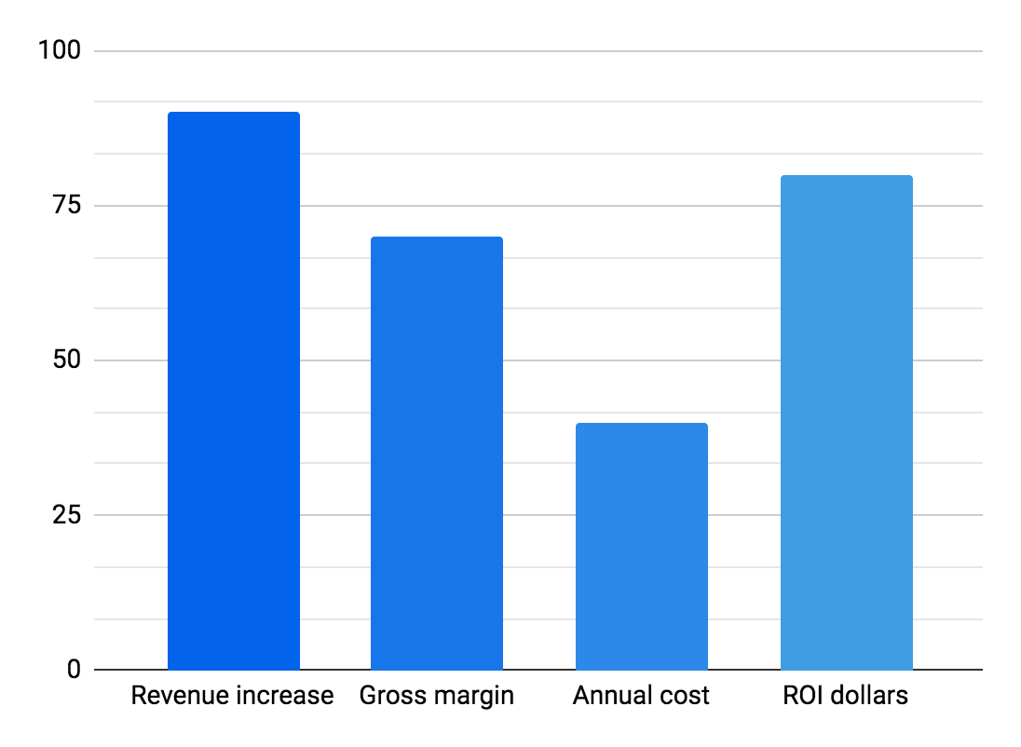
Return on investment (ROI) infographics
Revenue increase
Gross margin
Jupiter is a gas giant and the biggest planet
Mercury is the closest planet to the Sun
Annual cost
ROI dollars
Neptune is the farthest planet from the Sun
Despite being red, Mars is really a very cold place
$127,980
90%
70%
40%
80%
Return on investment
Follow the link in the graph to modify its data and then paste the new one here. For more info, click here

Slide 10
Return on investment (ROI) infographics
Vanity metrics
Bounce rate | Sharing stats. | Open rate | List size
Jupiter is a gas giant and the biggest planet | Neptune is the farthest planet from the Sun | Mercury is the closest planet to the Sun | Despite being red, Mars is a cold place
ROI metrics
Deliverability rate | Click through rate | Read rate | Form conversions
Venus has a beautiful name but is hot | Earth is the third planet from the Sun | Pluto is considered a dwarf planet | Ceres is located in the main asteroid belt

Slide 11
Return on investment (ROI) infographics
01
Website ROI calculation process
Traffic
Jupiter is a gas giant and the biggest planet
03
02
Customers
Leads
Venus is the second planet from the Sun
Mercury is the closest planet to the Sun

Slide 12
Return on investment (ROI) infographics
$23,300
65%
$12,000
1.76
Actual cost of work performed
Return on investment
Estimated cost variance
Cost performance index
Mercury is the closest planet to the Sun
Despite being red, Mars is a cold place
Jupiter is a gas giant and the biggest planet
Neptune is far away from Earth

Slide 13
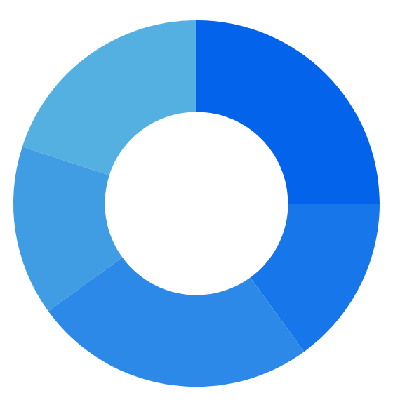
Return on investment (ROI) infographics
20%
Effect on revenue
Jupiter is a gas giant and the biggest planet
25%
Effect on costs
15%
Data science
Neptune is the farthest planet from the Sun
Team efficiency
Mercury is the closest planet to the Sun
ROI
15%
Competitive edge
25%
Despite being red, Mars is a cold place
Speed-to-value
Venus has a beautiful name but is hot
Follow the link in the graph to modify its data and then paste the new one here. For more info, click here

Slide 14
Return on investment (ROI) infographics
Success
01
02
Investment
Despite being red, Mars is a cold place
Jupiter is a gas giant and the biggest planet
Sales
03
ROI
04
Interest
Pluto is considered a dwarf planet
Return on investment
Mercury is the closest planet to the Sun
Per capita
05
06
Return
Ceres is located in the main asteroid belt
Venus has a beautiful name but is hot

Slide 15
Return on investment (ROI) infographics
01
Simple ROI calculation
(Total revenue - Marketing investment)
x 100
Marketing investment
02
Accurate ROI calculation
(Total revenue -Total COGS - Marketing investment)
x 100
Marketing investment

Slide 16
Return on investment (ROI) infographics
01
Cost
Jupiter is a gas giant and the biggest planet
02
Benefit
ROI
Mercury is the closest planet to the Sun
03
Time
Venus has a beautiful name but is hot

Slide 17
Return on investment (ROI) infographics
 | Data direct | Data indirect | Data direct | Data indirect
ROI data | Cost |  | Benefit
New product | 300 | 500 | 400 | 600
New equipment | 120 | 180 | 300 | 250
Website | 800 | 900 | 1,000 | 1,200
Social media | 1,500 | 2,000 | 1,670 | 2,300
Cost
Benefit
Venus has a very beautiful name but is actually terribly hot, hotter than Mercury
Mercury is the closest planet to the Sun and the smallest one in the entire Solar System

Slide 18
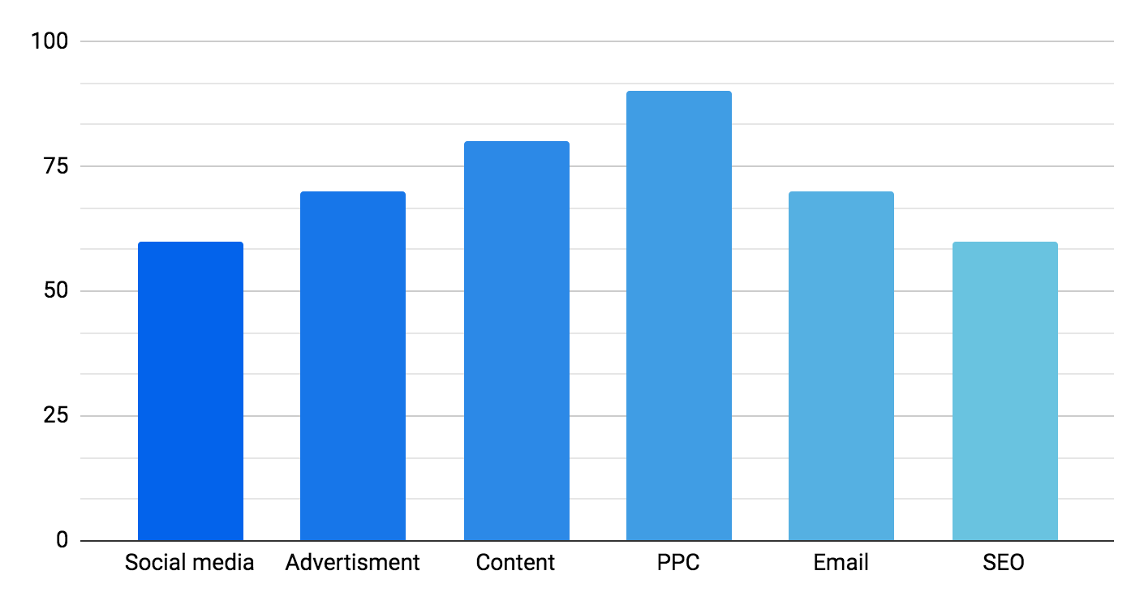
Return on investment (ROI) infographics
ROI (per $1 spent)
Venus has a very beautiful name but is actually terribly hot, hotter than Mercury
$60
$70
$80
$90
$70
$60
Follow the link in the graph to modify its data and then paste the new one here. For more info, click here

Slide 19
Return on investment (ROI) infographics
01
Pageviews
Jupiter is a gas giant and the biggest planet
02
Social interactions
Mercury is the closest planet to the Sun
03
Links from high value sites
ROI measurement for infographics
Venus has a beautiful name but is hot
04
Search engine rank
Earth is the third planet from the Sun
05
Direct leads
Neptune is the farthest planet from the Sun

Slide 20
Return on investment (ROI) infographics
ROI model
Evaluation
Practice
Process
Operation
Implement
Mercury is the closest planet to the Sun
Jupiter is the biggest planet of them all
Despite being red, Mars is a cold place
Earth is the third planet from the Sun
Venus has a beautiful name but is hot

Slide 21
Return on investment (ROI) infographics
Social media ROI
25%
50%
Audience reach
Engagement
Mercury is the closest planet to the Sun
Jupiter is a gas giant and the biggest planet
30%
40%
Clicks to site
Conversion rate
Despite being red, Mars is a cold place
Neptune is the farthest planet from the Sun

Slide 22
Return on investment (ROI) infographics
Time
Cost
Mercury is the closest planet to the Sun and the smallest one in the entire Solar System
Saturn is a gas giant and has several rings. It's composed mostly of hydrogen and helium
ROI
Venus has a beautiful name, but is hot. It’s also the second planet from the Sun
Gain from investment
Cost of investment

Slide 23
Return on investment (ROI) infographics
Action
04
01
Exposure
Despite being red, Mars is a cold place
Jupiter is a gas giant and the biggest planet
Four stages ROI model
Influence
03
02
Engagement
Pluto is considered a dwarf planet
Mercury is the closest planet to the Sun

Slide 24
Return on investment (ROI) infographics
01
02
03
Absolute returns
Annualized returns
Total returns
Jupiter is a gas giant and the biggest planet
Neptune is the farthest planet from the Sun
Mercury is the closest planet to the Sun
6 types of returns
04
05
06
Point to point returns
Trailing returns
Rolling returns
Despite being red, Mars is a cold place
Venus has a beautiful name but is hot
Despite being red, Mars is a cold place

Slide 25
Return on investment (ROI) infographics
 | Investment | Benefits | ROI
Action A | $1,000 | $3,000 | 2
Action B | $1,000 | $1,500 | 0.5
Action A+B | $2,000 | $4,500 | 1.25

Slide 26
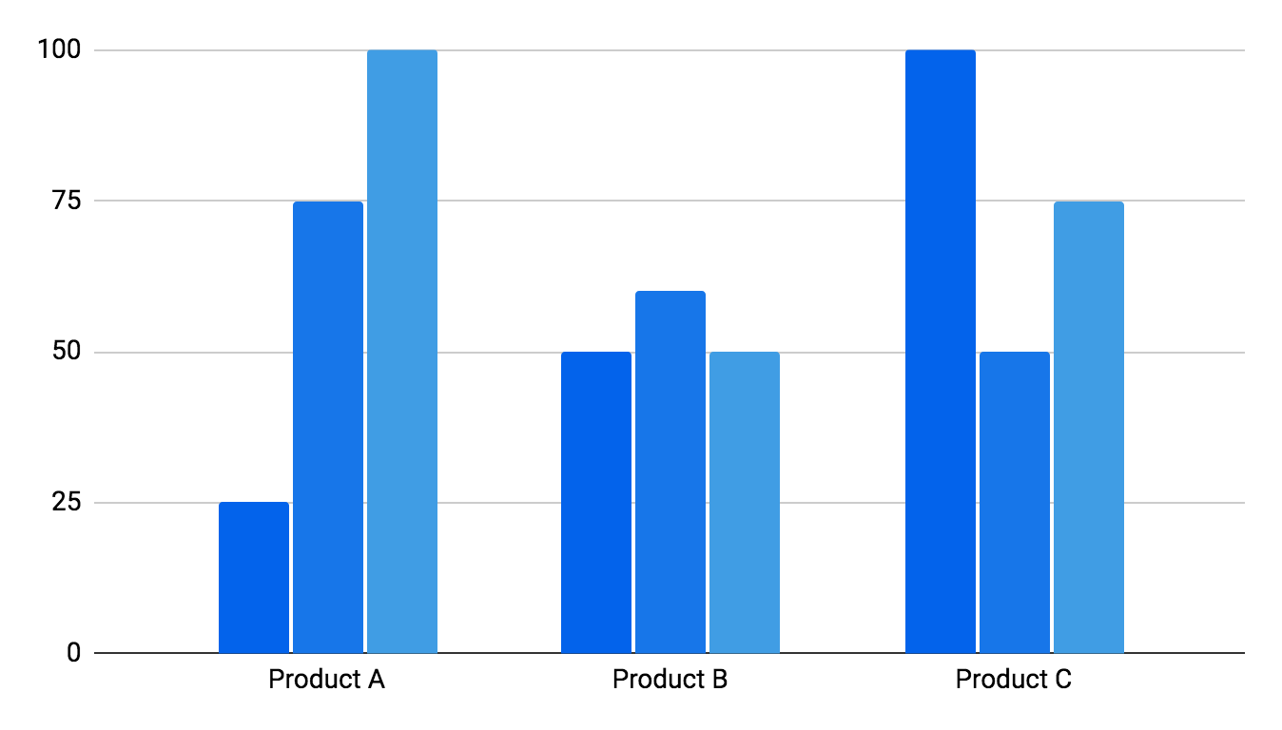
Return on investment (ROI) infographics
Return on investment
Mercury is the closest planet to the Sun and the smallest one in the Solar System. This planet's name has nothing to do with the liquid metal
+4,830
Cost
Time
ROI
Leads
Follow the link in the graph to modify its data and then paste the new one here. For more info, click here

Slide 27
Return on investment (ROI) infographics
4 types of ROI
01
02
03
04
ROI
ROO
ROE
ROA
Return on investment
Return on objectives
Return on engagement
Return on acquisition
Mercury is the closest planet to the Sun
Despite being red, Mars is a cold place
Jupiter is a gas giant and the biggest planet
Neptune is the farthest planet from the Sun

Slide 28
Return on investment (ROI) infographics
Marketing investment
Cost per thousand (CPM)
Cost per click (CPC)
ROI formula
Cost per lead (CPL)
(Total revenue - Marketing investment)
Cost per action (CPA)
x 100
Marketing investment
Return on investment

Slide 29
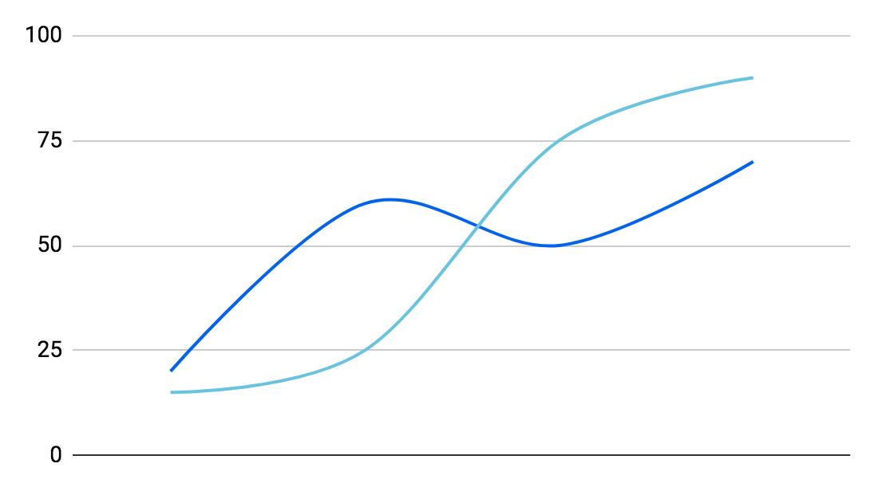
Return on investment (ROI) infographics
Investment
Saturn is a gas giant and has several rings. It's composed of hydrogen and helium
Benefit
Venus has a very beautiful name but is actually terribly hot, hotter than Mercury
ROI
$6,324.200
Jupiter is a huge gas giant named after the Roman god of the skies and the lightning
Follow the link in the graph to modify its data and then paste the new one here. For more info, click here

Slide 30
Return on investment (ROI) infographics
Stage
Four stages ROI model
04
Action
Despite being red, Mars is a cold place
Stage
03
Influence
Pluto is considered a dwarf planet
Stage
02
Engagement
Mercury is the closest planet to the Sun
Stage
01
Exposure
Jupiter is a gas giant and the biggest planet

Slide 31
Return on investment (ROI) infographics
5 steps before measuring campaign ROI
01
Define goals
02
Jupiter is a gas giant and the biggest planet
Use the right tools
Neptune is the farthest planet from the Sun
03
Integrate channels
04
Mercury is the closest planet to the Sun
Life cycle value
Despite being red, Mars is a cold place
05
Multi-wave campaign
Venus has a beautiful name but is hot

Slide 32
Return on investment (ROI) infographics
Mercury is the smallest planet
Jupiter is the biggest planet
Venus is the second planet from the Sun
$360
$60
500%
$5
100
$60
Earth is the third planet from the Sun
Neptune is far away from Earth
Despite being red, Mars is a cold place

Slide 33
Instructions for use (premium users)
In order to use this template, you must be a Premium user on Slidesgo.
You are allowed to:
Modify this template.
Use it for both personal and commercial purposes.
Hide or delete the “Thanks” slide and the mention to Slidesgo in the credits.
Share this template in an editable format with people who are not part of your team.
You are not allowed to:
Sublicense, sell or rent this Slidesgo Template (or a modified version of this Slidesgo Template).
Distribute this Slidesgo Template (or a modified version of this Slidesgo Template) or include it in a database or in any other product or service that offers downloadable images, icons or presentations that may be subject to distribution or resale.
Use any of the elements that are part of this Slidesgo Template in an isolated and separated way from this Template.
Register any of the elements that are part of this template as a trademark or logo, or register it as a work in an intellectual property registry or similar.
For more information about editing slides, please read our FAQs or visit Slidesgo School:
https://slidesgo.com/faqs and https://slidesgo.com/slidesgo-school

Slide 34
Infographics
You can add and edit some infographics to your presentation to present your data in a visual way.
Choose your favourite infographic and insert it in your presentation using Ctrl C + Ctrl V or Cmd C + Cmd V in Mac.
Select one of the parts and ungroup it by right-clicking and choosing “Ungroup”.
Change the color by clicking on the paint bucket.
Then resize the element by clicking and dragging one of the square-shaped points of its bounding box (the cursor should look like a double-headed arrow). Remember to hold Shift while dragging to keep the proportions.
Group the elements again by selecting them, right-clicking and choosing “Group”.
Repeat the steps above with the other parts and when you’re done editing, copy the end result and paste it into your presentation.
Remember to choose the “Keep source formatting” option so that it keeps the design. For more info, please visit Slidesgo School.

